Slide 1
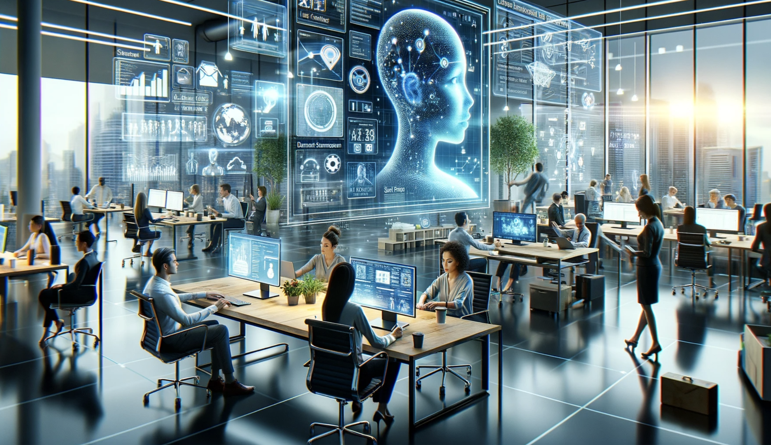

fynal
multi-human and multi-agents collaboration
to solve complex problems
request for teaser @刘克鸿

Slide 2
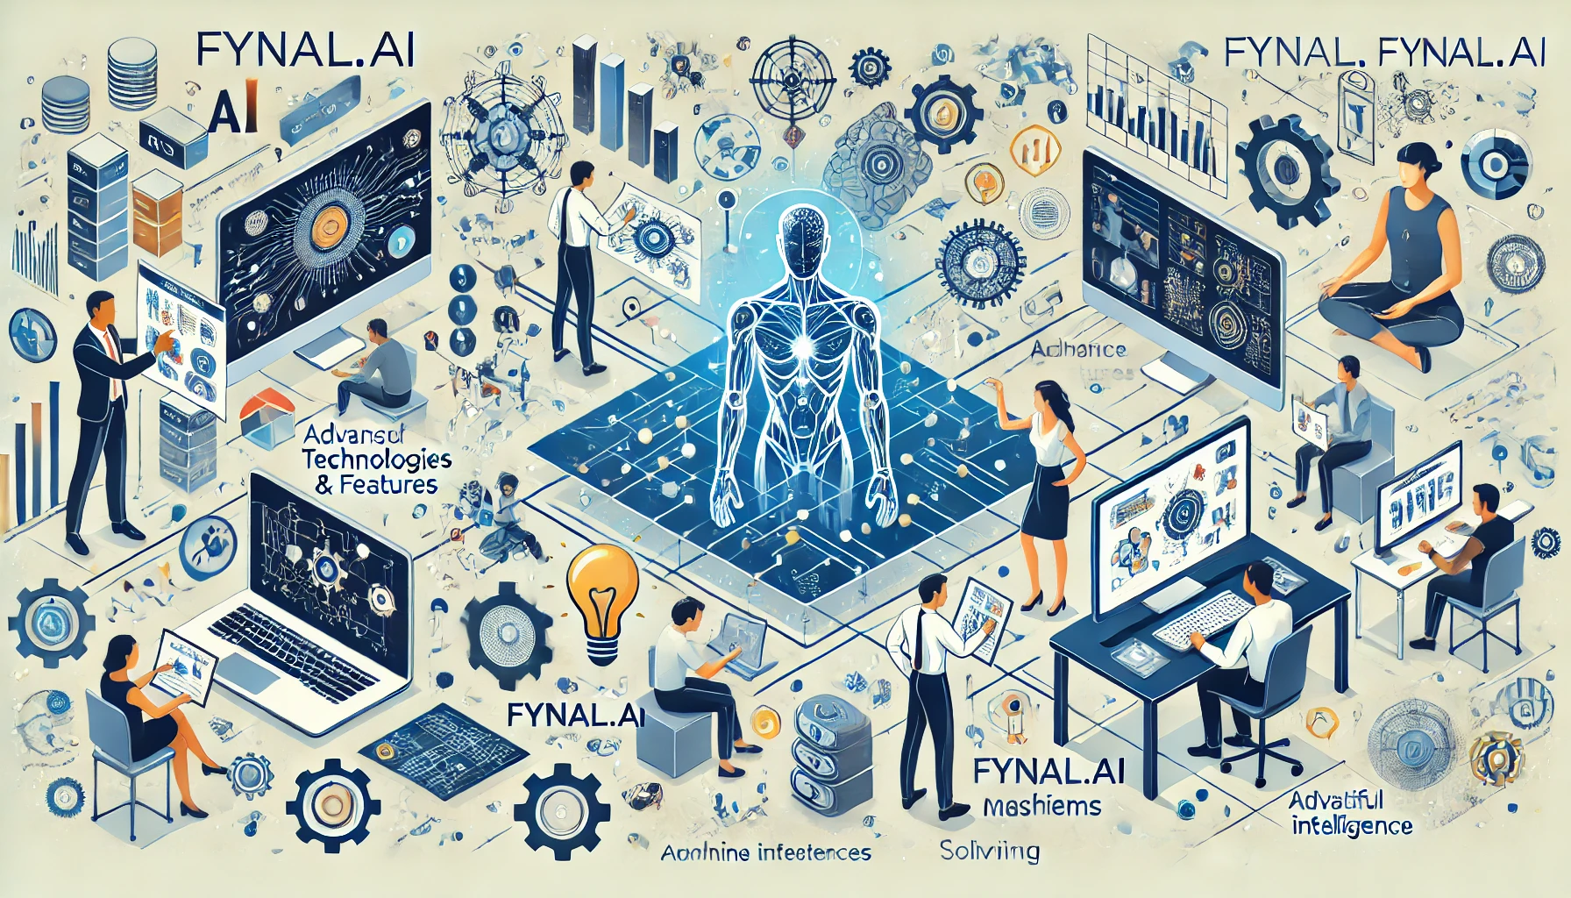
fynal
multi-human and multi-agents collaboration
to solve complex problems
request for teaser @刘克鸿

Slide 3
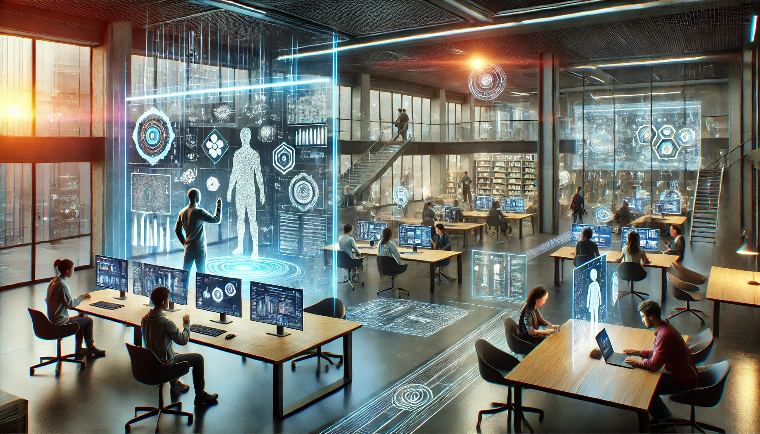
fynal
multi-human and multi-agents collaboration
to solve complex problems
request for teaser @刘克鸿

